Slide 1
Data Warehouse Concepts Part 1
<Data Warehouse101 Series>
Anand Kumar
Notes:
‹#›
Hi, we present to you few slides that will teach you a lot about Data Warehousing.
We have broken this down to a two presentations lesson for you, so that we can cover as much as possible without draining you in one presentation itself. And this module will cover the Data warehousing concepts.
Let’s proceed.
Confidential © 2008 Wipro Ltd
‹#›

Slide 2
Data Warehouse Concepts Overview
Data Warehouse Concepts Part 1 covers ,
The definition of Data Warehouse
The need for the Data Warehouse
Difference between Transaction Processing and Query Processing
Definition of Data Mart
Data warehouse Concepts Part 2 covers,
Definition of ODS
Data Warehouse architecture
Data Warehouse tools
Notes:
Data warehouse contains data which is used for query and analysis purpose. For e.g. Users may want to know the amount of sales that happened for HP Desktop in Bangalore in last 5 years?
Or
Laptop sales has grown by what percent in last 5 years? What promotion schemes have boosted the sales volume?
These questions, search data from last several years and find the details. So data warehouse mostly contains historical data and enables operation upon this data to generate reports and help analytical queries. It is different from transaction processing since it does not contain a lot of updates and deletes. There may not be many active users for data warehouse who would run analytical queries but there would be many users who will get the reports generated by the data warehouse system.
The other important aspects attached with data warehouse is ETL (extract, transform and load) and reporting tools apart from the different database design (different than transactional system). The ETL and reporting tools play an important role as they provide easy to use GUI enabled, drop down features to develop data transfer process to multiple types of reports, dashboards very quickly.
We shall go through the definitions, data warehouse terms, concepts ,evolution and need for the data warehouse.
As said earlier, these details are covered in two parts. This presentation is part 1 of the series.
© 2009 Wipro Ltd – Internal & Restricted
‹#›

Slide 3
Data Warehouse Concepts Objectives
Upon completion of this module you will be able to:
Understand the need of Data Warehouse
Understand the difference between Data Warehouse and Transaction Processing
What is Data Mart
Notes:
A data warehouse system has multiple components.
One - the database design,
two - the tools to load the data into the database,
And three - the tools which generate reports from the data. Here we will try to understand what are terms and concepts used in a database design.
Upon completion of this module you will be able to
Understand the need of a Data Warehouse
Know the difference between Data Warehouse and Transaction Processing
Understand what a Data Mart is
Compare the characteristics of Data mart and Enterprise DWH

Slide 4
Outlines
Lesson 1 Data Warehouse Overview
Lesson 2 Need for Data Warehouse
Lesson 3 OTLP Vs Warehouse Applications
Lesson 4 Data marts Vs Data Warehouses
Notes:
‹#›
The module has 4 Lessons.
Data warehouse Overview,
Need for data warehouse,
OLTP Vs Warehouse Application,
And Data marts Vs Data Warehouse.

Slide 5
Data Warehouse Overview
Subject-Oriented, Integrated characteristics and Its evaluation
Notes:
‹#›
We begin with the overview to Data warehouse.
Data warehouse is a special form of data base which works on large volume of data specifically for decision support system.
The decision support system is for senior management of the company who see the analyzed data of multiple months/years and decide upon the future actions.
For e.g. the management would want to analyze the laptop sales across multiple Indian cities in past several months for which they need answers to important questions like - Which city is leading, which is lagging, what more can be done to boost the sale in area which is lagging. What kind of configuration is liked more etc. It gives the visibility in terms of trend, growth, fall, preference, changes etc of business process under consideration.
The data under consideration is generally historical but now the management might want to see the recent data and very recent data like current date or current hour of data as well.
To cater to these needs the data ware house is developing new tools and techniques. It is still an evolving system , providing new and better features.
Here we will cover the definition, characteristics and evolution of data warehouse.

Slide 6
What is a Data Warehouse ?
Can I see credit report from Accounts, Sales from marketing and open order report from order entry for this customer
Data from multiple sources is integrated for a subject
A data warehouse is a subject-oriented, integrated nonvolatile,
time-variant collection of data in support of management's
decisions.
- WH Inmon
Identical queries will give same results at different times. Supports analysis requiring historical data
Data stored for historical period. Data is populated in the data warehouse on daily/weekly basis depending upon the requirement.
WH Inmon - Regarded As Father Of Data Warehousing
Notes:
‹#›
WH INmon (who is regarded as father of data warehousing) defines data warehouse as ‘A subject-oriented, integrated, nonvolatile, time-variant collection of data in support of management’s decisions’
Let’s look at each of the terms highlighted.
Subject Oriented : It represents a Business process. Process specific data is structured (data-modeled) in separate subject areas which are interlinked. Star schema facts & dimensions are designed based on BU (business unit) specific requirements. The example of process are sales, inventory, accounting, loan etc.
Integrated – Data coming from multiple source systems is captured and integrated (co-located and functionally integrated) in DWH data repository.
Source systems can be,
Operational sources internal to enterprise
External 3rd party vendor product systems
Stand alone source like spreadsheets, flat files
Master data from agencies like Credit rating, D&B (Dun & Bradstreet)
Non-volatile – Data is static and remains constant. Does not undergo change with passage of time. Gives consistent query results on the same data set at different times.
DW database state is changing (volatile) to the extent of incremental data load schedule. No frequent updates, rare delete based on business requirement.
The data for the sales which took place in last several years are not changed. The sales happening in current month or days can change to apply corrections, back orders etc.
So old data which is loaded in the data warehouse is almost non changeable data.
Time-variant – History of data changes can be maintained as per business requirements.

Slide 7
Subject-Oriented- Characteristics of a Data Warehouse
Operational
Data
Warehouse
Leads
Prospects
Customers
Products
Quotes
Orders
Time
Regions
Focus is on Subject Areas rather than Applications
Notes:
‹#›
Let’s dig into characteristics of data warehouse further:
In Data warehouse as depicted in the example, the focus is on subject areas which are more abstract, rolled up to a higher level than OLTP applications.
Due to subject area orientation, data from multiple applications can integrate and reside in the common database repository i.e. DWH.
The difference is shown here: While operation data consider Leads, prospects, quotes and orders; the data warehouse considers customers, products, regions and time. Further the customers, products, regions and time eventually become the dimensions for the measures.
The measures can be sales volume, sold items etc. The sales volume or sold items are analyzed in terms of customer, products, regions and time. For e.g. In January month of 2009 what is the region wise sales of Maruti 800 cars. In October month of 2009 what is the region wise sales of Maruti 800 cars. October is a festival month in India, so there will be more sales. This will also tell how much have sales increased during festival months. The data warehouse is not concerned that the sales application running fine or not; or how the day to sales data management is handled.

Slide 8
Integrated - Characteristics of a Data
Warehouse
Appl A - m,f
Appl B - 1,0
Appl C - male,female
Male, female
Appl A - balance dec fixed (13,2)
Appl B - balance pic 9(9)V99
Appl C - balance pic S9(7)V99 comp-3
balance dec
fixed (13,2)
Appl A - bal-on-hand
Appl B - current-balance
Appl C - cash-on-hand
Current balance
Appl A - date (julian)
Appl B - date (yymmdd)
Appl C - date (absolute)
date (julian)
Integrated View Is The Essence Of A Data Warehouse
Notes:
‹#›
The second characteristic of the Data Warehouse is ‘Integrated View’.
Integrated View Is The Essence Of A Data Warehouse.
What it means is that attributes of entity type should be represented as one value, despite the multiple source systems it may come from in multiple forms.
Instances of integration of data from multiple source applications in terms of reference codes, data type rationalization, data element finalization in target Data Warehouse are depicted here.
For e.g. Application A sends male, female attribute (column) as m, f.
Application B sends the same as 1, 0.
Application C sends them as male, female.
The data warehouse stores always as male, female. So all the applications / users who are taking the data from data warehouse will see male, female all the time. It is a clear representation, they don’t have to remember the code or look somewhere else for meaning of m or f.
In the third example: Application A sends the attribute name as bal-on-hand, application B sends the attribute name as current-balance and application C sends the attribute name as cash-on-hand. All represent the same item. In Data warehouse the attribute is named as current balance. Henceforth for all the applications/ users taking data from data warehouse will refer the column as current balance. It integrates the attribute or column name.

Slide 9
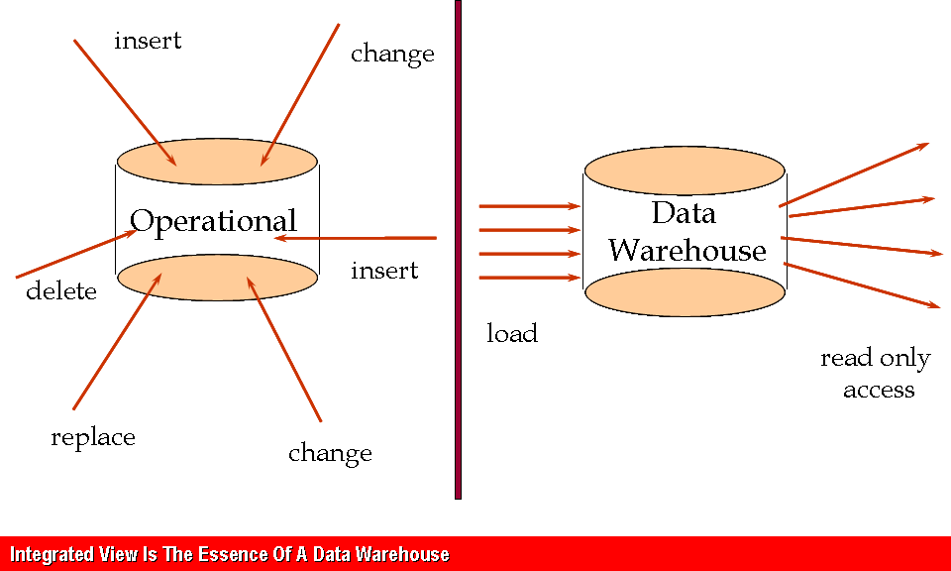
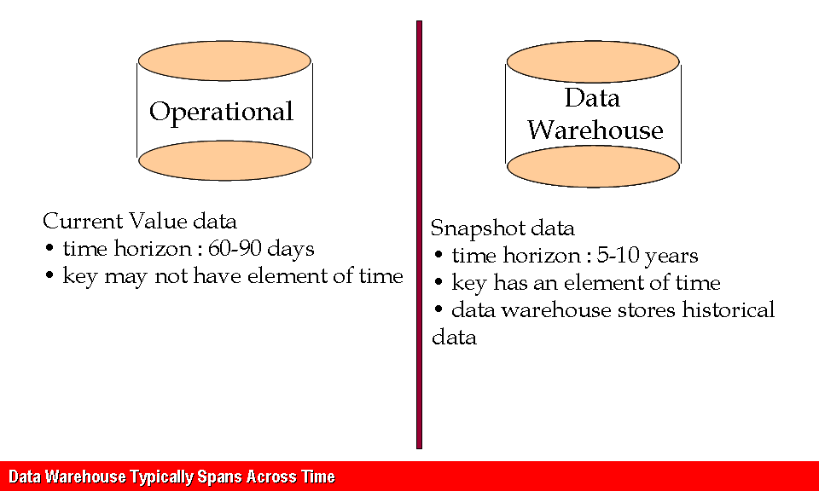
Characteristics of a Data Warehouse
Non Volatile
Time Variant
Notes:
‹#›
Let us understand the Non-volatile characteristic of data warehouse – Operational application data is volatile. Frequent insert, update and delete operations take place on the data.
Data Warehouse data is static, non-volatile. One time history and incremental data is loaded into Data Warehouse. Read only access (Query) is given to the data captured in Data Warehouse. No update and delete access rights are provided to the business users.
For example when a person joins the company his details are entered into the Human resource system, a transactional system. His details can be modified if it is entered wrongly. Once it goes to Data warehouse it is not allowed to change.
The fourth characteristic of data warehouse is time variant–
Operational applications maintain the current snapshot state of data. Only short term (around 60-90 days) transactional data is maintained. Master and reference data is maintained for ever and has no time period constraint. History of data changes is not maintained and hence the Primary Key of the tables will not have date/time attribute forming it.
Data warehouse – Maintains history of data (transactions, master / reference data changes) as per the data retention period requirements. (e.g. 5-10 years)
Primary key of the Data warehouse tables have date/time attributes to enable history maintenance.
It stores historical data.
Continuing with the same example of employee joining the company, when a person joins the company his details are saved in the Human Resource system which is a transactional system. For e.g. at the time of joining he is unmarried. These details after some time go to data warehouse. After a year the person marries. His details are modified in Human Resource system. The HR system has updated details. This data is sent to Data warehouse. A new record of Employee is inserted which shows that he is married now. If some body refers to employee changes for last one year one can see both the records. The same is not there in HR system.

Slide 10
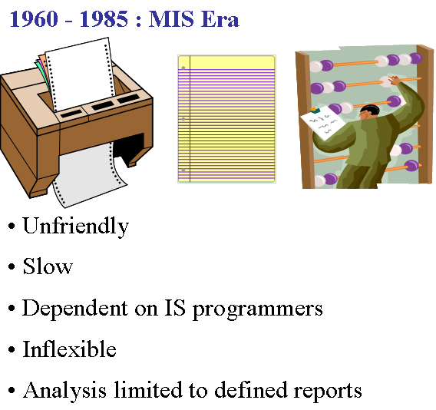
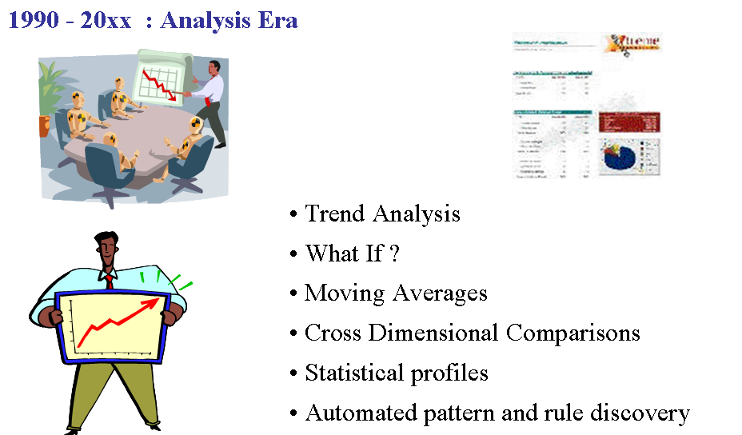
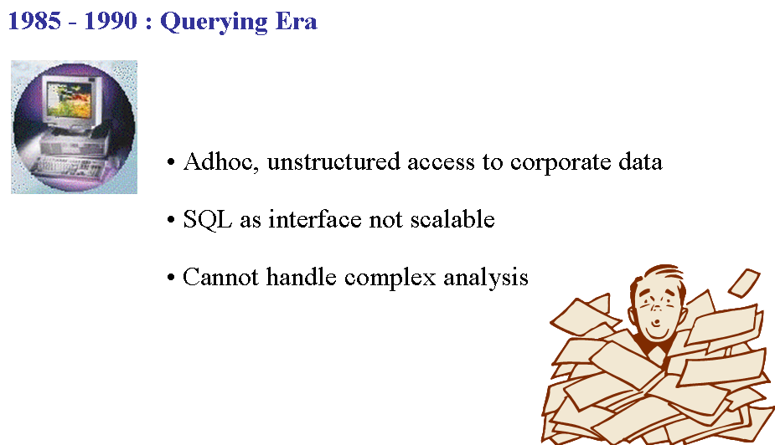
Evolution of Data Warehousing
Focus on Reporting
Notes:
‹#›
The Evolution of Data warehousing took place behind the changing business end user requirements.
In 1960 to 1985 period (also known as MIS Era) the Information System was not very friendly. It was slow, dependent on Information System programmers, inflexible and analysis was limited to defined reports. The reports were not generated on the fly. The changes in reports required a longer period. The memory and hardware were limited and used to be shared for multiple applications.
In 1985 to 1990 (Also known as Querying era) the Information system became better. It provided Adhoc, unstructured access to corporate data.
The ad-hoc feature provided the flexibility to user to run the query and generate report quickly.
SQL came as an interface but it was not scalable. The system couldn’t handle complex analysis. The SQL didn’t have analytical functions, and queries took a long time to execute.
From 1990 and forward (also known as analysis era) : The Information system enhanced well.
It can now cater to Trend analysis, provides What if feature, shows moving averages of data, provides cross dimensional comparisons of data,
Shows statistical profiles and can show automated pattern and rule discovery.
One can see the trend such as when people go to buy clothes are they looking for traditional clothes or new trendy clothes like Jeans and tops.
In stock analysis on can see what is last 100 days moving average of stocks or last 200 days of moving average. These moving average provides some glimpses how the market is behaving. In the cross dimensional analysis like what product is sold at what time in what region. The various dimensions involved are product, time and region.
Under data mining capabilities the data patterns are established and rules are discovered in very large database. It is used in marketing, surveillance, medical (genetic pattern establishment) etc industry.

Slide 11
Need for Data Warehousing
Notes:
‹#›
Data warehouse is an essential method to gather reports on the functioning of enterprise processes. It analyses months or years of data and creates a summary reports from them.
The reports can be of various types, such as total sales, profit, comparison of sales across various regions, budget versus actual data, dashboard. The reports can be generated on scheduled basis or on ad-hoc basis.
Data can be taken from database or OLAP (Online analytical process) cubes. More on OLAP cubes is covered in advanced reporting modules.
The need of data warehouse is across all the industries and across all the functioning. We have seen the examples of sales frequently, let us see for e.g. how it helps in accounting.
In accounting one major exercise is budgeting. The budget amount for various cost centers is prepared in start of financial year. At the end of financial year or financial quarters the budgeted amount versus actual spending is analyzed. This helps in finalizing details for future.
We will read more on the various needs for Data Warehousing in the next slides

Slide 12
Need for Data Warehousing
Better business intelligence for end-users
Reduction in time to locate, access, and analyze information
Consolidation of disparate information sources
Strategic advantage over competitors
Faster time-to-market for products and services
Replacement of older, less-responsive decision support systems
Reduction in demand on IS to generate reports
Notes:
‹#›
Reasons for data warehousing are many. We shall go through them one by one:
-Better business intelligence for end-users:
Business end users will be able to derive actionable information from the data stored in data warehouse as the data is subject-oriented and history is maintained.
From the volumes of data they can see the pattern, statistics, year to year analysis, actual versus budget analysis, dashboards etc all with great flexibility.
These add value to business. They can take fast decision.
-It provides reduction in time to locate, access, and analyze information:
The way the data is organized helps in, quicker query results, fast runs of analytical queries and quicker delivery of reports.
-Consolidation of disparate information sources:
With the enterprise data warehouse data from multiple sources is consolidated and presented in one format to the user.
In enterprise data warehouse it has single data repository.
Even in data marts also data from multiple sources are combined and single presentation is given to users.
-Strategic advantage over competitors:
In data warehouse, detailed granular data can be stored for longer duration of time period. With access to this detailed granular data, trend and behavior analysis can be done giving the strategic advantage over competitors. For e.g. if one garment selling company establishes data warehousing the management can see the people latest demands, people preferences, and tune the manufacturing or procurement accordingly. With data warehouse they get all the information much quickly rather than company which does not have data warehouse and rely on sales persons to tell the customers demands. In latter case the company needs frequently call the meetings of sales persons from various locations and gather details from them. This takes time.
With detailed, readily available integrated data, new product development / service launches can be rolled out faster.
-Replacement of older, less-responsive decision support systems
If the sales and accounting have independent legacy data warehouse systems, it was difficult to get the integrated view. The sales department gives sales data and accounts dept gives revenue, expense etc data. To see both on the same platform and queries to work across sales and accounting domain is catered by the single integrated enterprise wide DWH system.
With readily available transformed data and business semantic layer development, business end users (with limited / no SQL query skills) can generate ad-hoc reports as per needs.
The reporting tools come with ad-hoc query features. The end users can run the queries and get the results. They need not be dependent for all the queries on Information system (technical) people.

Slide 13
OLTP Vs Warehouse
OLTP Vs Warehouse and need for separate database
Notes:
‹#›
OLTP and Data Warehouse has two different types of requirements.
Earlier reports were generated from OLTP. But it came out that it took more time to generate the reports from OLTP system.
To provide reports faster and for more flexibility in report generation, the data warehouse system came into being.
The OLTP system caters day to day functioning of business processes. The data warehouse analyses and see the performance of business processes.
The data warehouse system is built over the data of OLTP.

Slide 14
OLTP Vs Warehouse
Operational System | Data Warehouse
Transaction Processing | Query Processing
Time Sensitive | History Oriented
Operator View | Managerial View
Organized by transactions (Order, Input, Inventory) | Organized by subject (Customer, Product)
Relatively smaller database | Large database size
Many concurrent users | Relatively few concurrent users
Volatile Data | Non Volatile Data
Stores all data | Stores relevant data
Not Flexible | Flexible
Notes:
‹#›
Let us see the differences in OLTP and data warehouse in more detail:
OLTP (online transaction processing) or operation system – Does transaction processing (responsible for daily operations of business), The data warehouse is specifically confined to query processing.
OLTP maintains current state (snapshot) of data. Does not maintain history of data changes. The data warehouse maintains history of data.
OLTP provides operator view enabling tactical operational decision making. The operator has to see day to day data, for example what is the daily inventory, how many tickets has been issued today, the software should be running up and perfectly so it should not stop the processes etc.
Data warehouse gives managerial view as the trend, behavioral analysis, performance with ad-hoc query feature. Say, it will see the daily inventory for last 30 days and find out that is the inventory adequate or less or more than the required.
OLTP data is organized by transactions aligning to the business processes, the data warehouse is by subjects and rolled up to a higher level than operational applications. For e.g. the daily inventory checking in operational system is not needed in data warehouse. Here it will see the last 30 days inventory levels or average of inventory levels in last 30 days. The data is rolled up. The roll up means seeing the data from one level up in the summary process.
OLTP has smaller database size as it does not maintain history; data warehouse has huge volume of data as it maintains history for longer time period. The smaller database of OLTP system means the older data say one year or two year old data is taken offline for e.g. kept in tape storage. The data is not deleted very fast. The very old data may be 5 or ten years old data can be deleted if the business permits. IN data warehouse the data for last 5-10 years is kept active in database. The old data is not kept active in OLTP system, since it will slow down the daily data processing operations.
OLTP has many operational users accessing the OLTP data at the same time (high user concurrency), the data warehouse has few users.
OLTP has volatile data with frequent insert, update and delete operations. Data warehouse data is static. Here the Incremental data load takes place and data is accessed in the form of querying / reporting. Data deletion is rare and only for specific requirement.
OLTP captures all the data elements required for business process transaction integrity and completeness, the data warehouse captures relevant data only from source systems. For e.g. in OLTP it is important to know who inserted the record or who deleted the record. In data warehouse it has almost no use.
In OLTP, system is not flexible to handle changes to the business process (like adding / removing new columns) as this impacts the front end application, middle layer business application logic and the back end database schema changes. data warehouse is flexible to the changing the business needs (adding new data elements, bringing new source data into DW).

Slide 15
Do we need a separate database ?
OLTP and data warehousing require two very differently configured systems
Isolation of Production System from Business Intelligence System
Significant and highly variable resource demands of the data warehouse
Cost of disk space no longer a concern
Production systems not designed for query processing
Notes:
‹#›
While they are good reasons for a Data warehouse to be different from OLTP, is it important that there be a different database for each of it?. Yes it is:
OLTP and DW systems objective and usage are different. OLTP needs quick search, update, delete property. There are multiple users who want to update the system.
The tables are designed to have capability to provide quick updates, so database locks are not kept on for long times. The updates are required on a part of data, like employee location, employee skill, employee department etc. So data is generally stored in 3rd normal form.
Data ware house requires big queries, queries which will search the data through many months or many years. The data storage area has to be big.
The database is tuned for query optimization.
Isolation of Production System from Business Intelligence System:
Business Intelligence requirements, which is query intensive should not burden the daily production system work load impacting the OLTP application performance.
DW resource demands are unpredictable as power users can fire resource intensive queries which needs to access large data volumes. The same is not true in OLTP.
In OLTP the queries are generally small, but volume is high.
Cost of disk space no longer a concern:
Separate DW repository will require additional disk space but the disk space is cheaper and hence extra disk space cost is not a concern. Earlier disk space was costly and scarce, but now the disk space in terabytes are also available at reasonable price. The server are scalable, it can accommodate many disks of Gigabytes or terabytes.
Production systems are not configured to handle heavy duty queries.
The production system has large no of tables in third normal form. If one need to show for e.g. country, state, district and town wise sales for desktop in a report; the query will join country, state, district and town tables. The joins will reduce the query performance. So in data warehousing the data from all these tables are combined and kept in one location table.

Slide 16
Data marts Vs Data Warehouses
Its Scope Perspective, sources and characteristics
Notes:
‹#›
Data marts are designed around individual business processes. Data warehouse is designed keeping the multiple processes or all processes of the enterprise.
For e.g. a data mart in accounting system can be designed for GL transaction, Ledger balance etc. But data warehouse will keep the data for all the processes of accounting or of the enterprise.
We will go through the details of data mart requirements and the comparison between data mart and DWH.

Slide 17
Data Marts
Definition:
Subject or Application Oriented Business View of Warehouse
Quick Solution to a specific Business Problem
Finance, Manufacturing, Sales etc.
Smaller amount of data used for Analytic Processing
Influence to have Data marts:
Enterprise wide data warehousing projects have a very large cycle time
Getting consensus between multiple parties may also be difficult
Departments may not be satisfied with priority accorded to them
Application/database distribution is also an important factor
Notes:
‹#›
The definition of Data mart is “Subject or Application Oriented Business View of Warehouse”.
It is suitable for department / BU specific requirements.
It takes less time to market and reduced implementation cycle time.
Reasons for choosing the Data mart are the negatives attached with the data warehouse.
Enterprise wide Data Warehouse project implementation takes longer time. The time can vary from months to a year or two. This requires a strong commitment from senior management. A large number of resources will be keep working on the project.
Enterprise wide Data Warehouse will involve all the enterprise BU / departments and getting consensus between them is difficult. Master data management issues – common, consistent definition of customer, product etc. often becomes difficult. The people are used to work with their own defined data sets. If one department works with for e.g. Male, female other with 1,0, another with m, f; they all are comfortable with their own data types. When the common report goes from data warehouse to all, they have to understand one way of representation.
Further there are Political issues in handling multiple BU/ departments, business user teams. For data representation or the way certain logic will be carried out each department wants to have its own way. Bringing people from multiple department to one platform takes time.
Selecting relevant data elements from available applications, de-duplication of data elements are major tasks
DW access priority finalization for business user groups / departments: Once the multiple reports are generated its important to finalize which department people can view which reports.
DW resources will be distributed among departments, which needs be carried out based upon the department data volume and complexity.

Slide 18
Data Warehouse and Data Mart
 | Data Warehouse | Data Marts
Scope | Application Neutral Centralized, Shared Cross LOB/enterprise | Specific Application Requirement LOB, department Business Process Oriented
Data Perspective | Historical Detailed data Some summary | Detailed (some history) Summarized
Subjects | Multiple subject areas | Single Partial subject Multiple partial subjects
Data Sources | Many Operational/ External Data | Few Operational, external data
Implement Time Frame | 9-18 months for first stage Multiple stage implementation | 4-12 months
Characteristics | Flexible, extensible Durable/Strategic Data orientation | Restrictive, non extensible Short life/tactical Project Orientation
Notes:
‹#›
We shall take a quick look at a few parameters on which Data warehouse and Data mart can be compared
Data warehouse is enterprise wide where as data mart is for department / BU.
Data warehouse is centralized, it serves as a central repository. The data mart is localized to specific business process.
Data Warehouse captures detailed data for the enterprise and is flexible used for ad-hoc query / analysis requirements. It has very few summary data. The data is kept in most granular form so it can be summarized later as per need.
Data mart has details for a particular business process and can have more summarized data.
In DW, objective is to bring as much detailed granular information as possible into DW and hence is driven by available data in source system rather than end user business requirements as the business requirements undergo changes over a period of time.
Data mart is implemented for the defined set of business requirements on the back of project sponsored by the impacted department.
There are multiple subject areas in Data warehouse as such Customer, Orders etc, While data mart has single or partial subject area such as customer etc.
Data warehouse has multiple source of data, The data will come from multiple departments. The data mart has relatively few source of data mostly restricted to one department.
Implementation time is more for Data ware house. It takes around 9-18 months for first stage to build. For data mart it takes 4-12 months.
The data warehouse is more flexible, extensible, durable and data oriented.
The data mart is restrictive, less extensible, has short life and project oriented. For e.g. the cost center hierarchy or account hierarchy details differ for different line of business (or department). Even the customer data may have some extra or different attributes for different departments.
Data marts in different department will differ for customer data. But in data warehouse it is kept most comprehensive so it can cater to all the departments. For e.g. say the customer credit related details is important for accounting but not for shipping department.
The shipping address is important for shipping department while billing address is important for accounting department and data marts in specific area will have different addresses.

Slide 19
Module Summary
Congratulations! You have now completed the 1st part of module of Data warehouse Concepts.
You should now be able
To Understand What is Data Warehouse
To understand to need for Data warehouse
To understand the Data Mart
Notes:
You would have now understood the purpose of Data warehouse and data marts, their evolution and characteristics, the difference between the two and their usage. Overall the data warehousing is a growing business with more and more company and industries are adopting to it to have better grasp of their businesses and increase their competitiveness.
With this we have come to the end of this effective presentation. Wish you good luck for what follows – a small quiz! Have a great day.

Slide 20
Quiz
Notes:
© 2009 Wipro Ltd – Internal & Restricted
‹#›

Slide 21
Question 1
Which is not the characteristics of Data Warehouse
The data is frequently updated, deleted.
The data is stored for a long time period of 5-10 years.
The data is mostly read only
The data shows the history of changes
Notes:
© 2009 Wipro Ltd – Internal & Restricted
‹#›

Slide 22
Question 1
Which is not the characteristics of Data Warehouse
The data is frequently updated, deleted.
The data is stored for a long time period of 5-10 years.
The data is mostly read only
The data shows the history of changes
Answer: A
Notes:
© 2009 Wipro Ltd – Internal & Restricted
‹#›

Slide 23
Question 2
Which is not the requirement from Data Warehouse environment?
Better business intelligence for end-users
Reduction in time to locate, access, and analyze information
Consolidation of disparate information sources
To provide user interface for online ticket booking
Notes:
© 2009 Wipro Ltd – Internal & Restricted
‹#›

Slide 24
Question 2
Which is not the requirement from Data Warehouse environment?
Better business intelligence for end-users
Reduction in time to locate, access, and analyze information
Consolidation of disparate information sources
To provide user interface for online ticket booking
Answer: D
Notes:
© 2009 Wipro Ltd – Internal & Restricted
‹#›

Slide 25
Question 3
Which is not the difference between Data Warehouse and OLTP ?
Data Warehouse is for Query Processing while OLTP is for Transaction Processing
Data Warehouse is History Oriented while OLTP is Time Sensitive
Data Warehouse has a less concurrent users while OLTP has more concurrent users
The Data Warehouse data is more dynamic than OLTP data
Notes:
© 2009 Wipro Ltd – Internal & Restricted
‹#›

Slide 26
Question 3
Which is not the difference between Data Warehouse and OLTP ?
Data Warehouse is for Query Processing while OLTP is for Transaction Processing
Data Warehouse is History Oriented while OLTP is Time Sensitive
Data Warehouse has a less concurrent users while OLTP has more concurrent users
The Data Warehouse data is more dynamic than OLTP data
Answer: D
Notes:
© 2009 Wipro Ltd – Internal & Restricted
‹#›

Slide 27
Question 4
Which is not the reason for a separate database for Data Warehouse ?
Production systems not designed for query processing
Isolation of Production system from Business Intelligence system
The configuration is different for Production system and Data Warehouse databases
The database size may be same for Data Warehouse and Production system
Notes:
© 2009 Wipro Ltd – Internal & Restricted
‹#›

Slide 28
Question 4
Which is not the reason for a separate database for Data Warehouse ?
Production systems not designed for query processing
Isolation of Production system from Business Intelligence system
The configuration is different for Production system and Data Warehouse databases
The database size may be same for Data Warehouse and Production system
Answer: D
Notes:
© 2009 Wipro Ltd – Internal & Restricted
‹#›

Slide 29
Question 5
What is correct about Data Mart ?
It is a quick solution to specific business area
Example of specific business area for Data Mart can be sales, order processing
Both are true
Both are wrong
Notes:
© 2009 Wipro Ltd – Internal & Restricted
‹#›

Slide 30
Question 5
What is correct about Data Mart ?
It is a quick solution to specific business area
Example of specific business area for Data Mart can be sales, order processing
Both are true
Both are wrong
Answer: C
Notes:
© 2009 Wipro Ltd – Internal & Restricted
‹#›

Slide 31
References
Notes:
© 2009 Wipro Ltd – Internal & Restricted
‹#›

Slide 32
References
Publications
Courses
The Data Warehouse Toolkit by Ralph Kimball, Margy Ross from Wiley Publication
DM 101 Data Model Concepts
OLAP concepts
URL’s
Training Programs
www.learndatamodeling.com

Slide 33
Thank You
Anand Kumar
Project Lead
Anand.akumar@wipro.com

